Slide 1
DD2437 - ANNDA
Lab assignment 4
Restricted Boltzmann Machines and
Deep Belief Nets
Notes:
Pawel, quick question

Slide 2
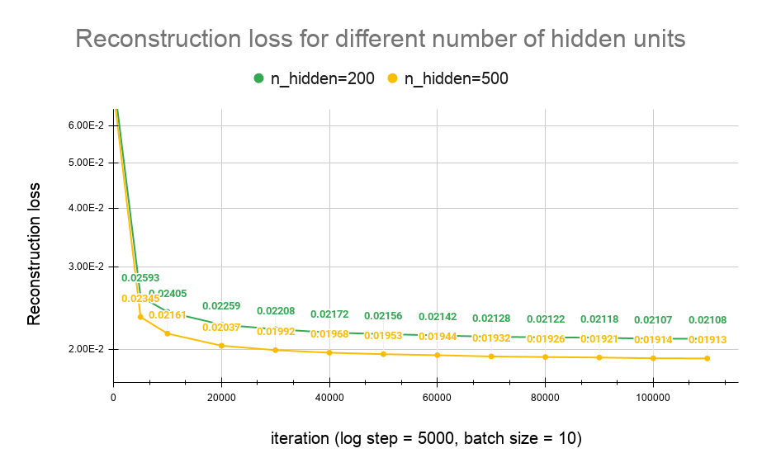
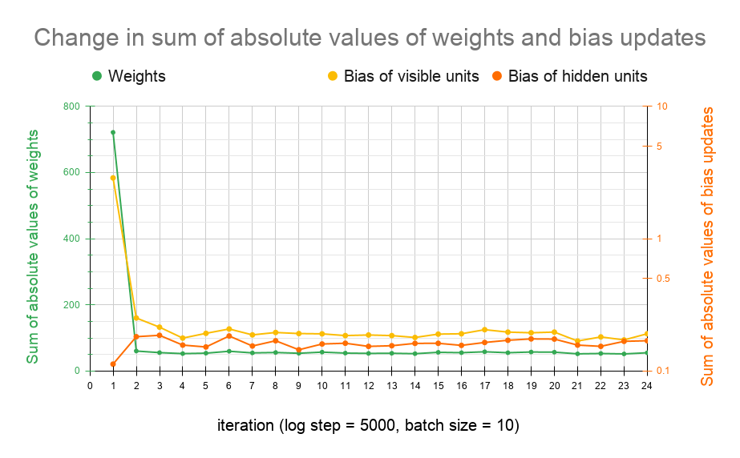
RBM for recognising MNIST images
More nodes give better reconstruction capabilities
Stabilization
Notes:
Self explanatory
Hilton’s paper training
Gibbs k=1:
Probabilities for visible layers
Sampling for hidden layer

Slide 3
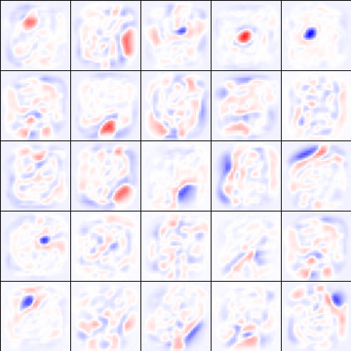
RBM for recognising MNIST images
Receptive fields of hidden nodes of interest
After 40 epochs
Notes:
b: negative, w: null, r: positive
Some areas become specialized to recognize loops or lines or empty spaces
Most of the receptive fields were hard to explain (like row 4, columns 2,3,4,5), that’s why we picked only some of interest.

Slide 4
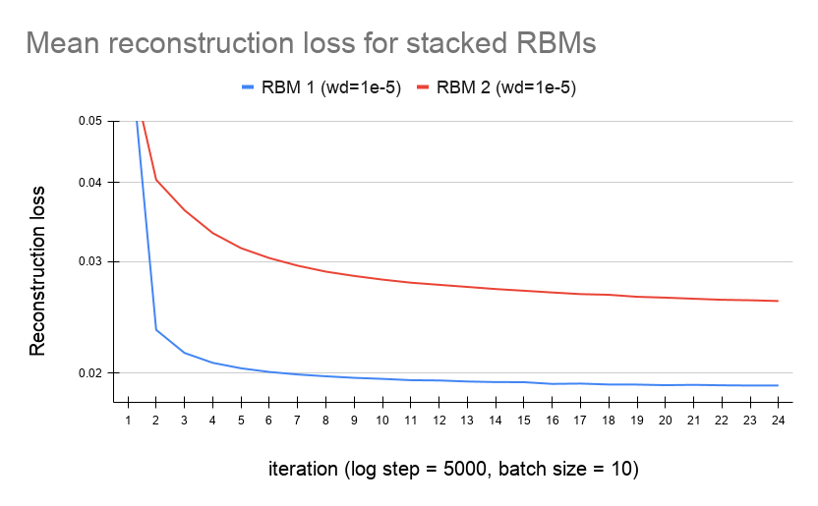
DBN: greedy layer-wise pretraining
Stack of 2 RBMs
(784-500-500)
Similar convergence
RBM 2 has a higher recon. loss
Notes:
For the second part of the assignemnt, we had to implement a deep belief network, a neural network built of several stacked RBMs. For training we used a scheme called greedy layer-wise pretraining, in which each RBM is trained separtely, from bottom to top, using the hidden layer of a previous RBM for the visual layer of the next RBM, and of course, the actual MNIST images in the bottom-most layer. To start we stacked two RBM’s a trained them according to this scheme. On the graph here we can see the reconstruction loss of both layers; RBM 1 performed slightly better with a similar rate of convergence.

Slide 5
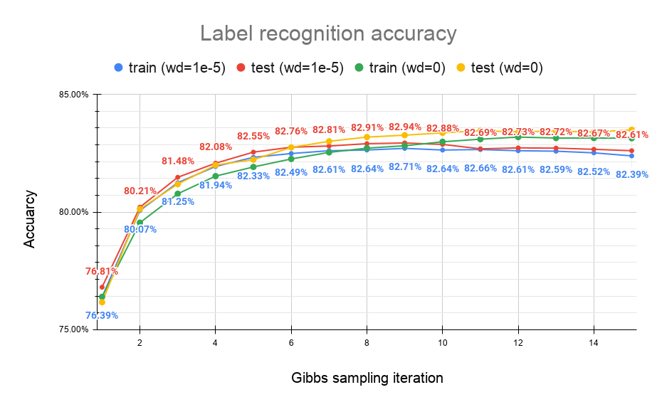
DBN: greedy layer-wise pretraining
adding a final layer
(500+10 - 2000)
Notes:
To complete the proposed architecture, we added the final, top RBM. The visible layer of the top RBM is 500 hidden nodes from the previous RBM as well as 10 extra units used for digit labels. The hidden layer has 2000 hidden units. On the graph here we can see the results of accuracy in regards to the number of Gibbs sampling iterations. We can see that the accuracy reaches a maximum at around 10 iterations, and it’s fairly similar for the tarin and the test data, with the test data sometimes even outperforming train data. Using weight decay made for a slightly worse accuracy.

Slide 6
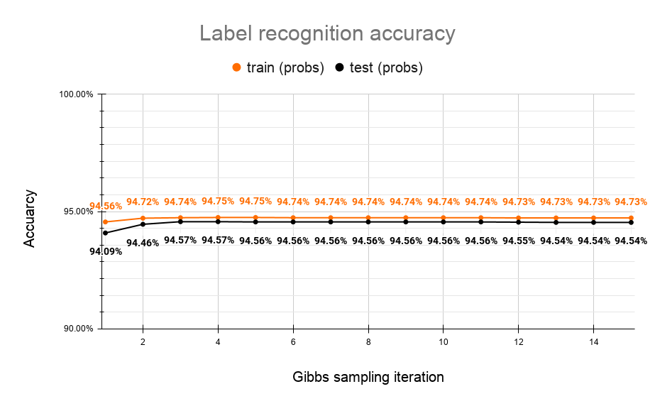
DBN: greedy layer-wise pretraining
Notes:
Huge gap in recognition accuracy performance: from 83% to 95%
Very high accuracy when passing probabilities from one RBM to the other
and when using only probabilities during Gibbs sampling in topmost RBM for recognition classification.
Having this modified network gave very bad results in picture generation.

Slide 7
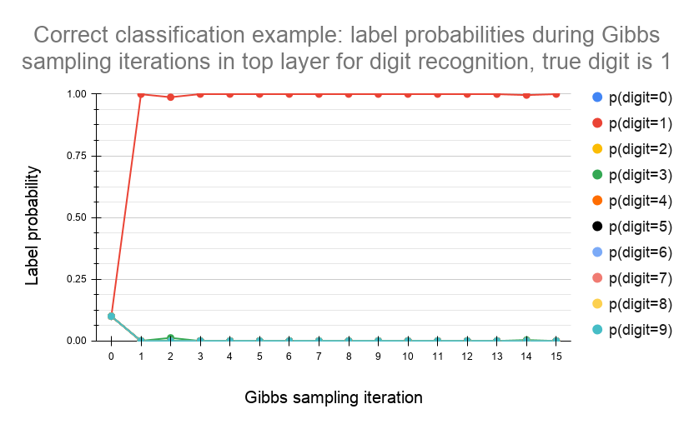
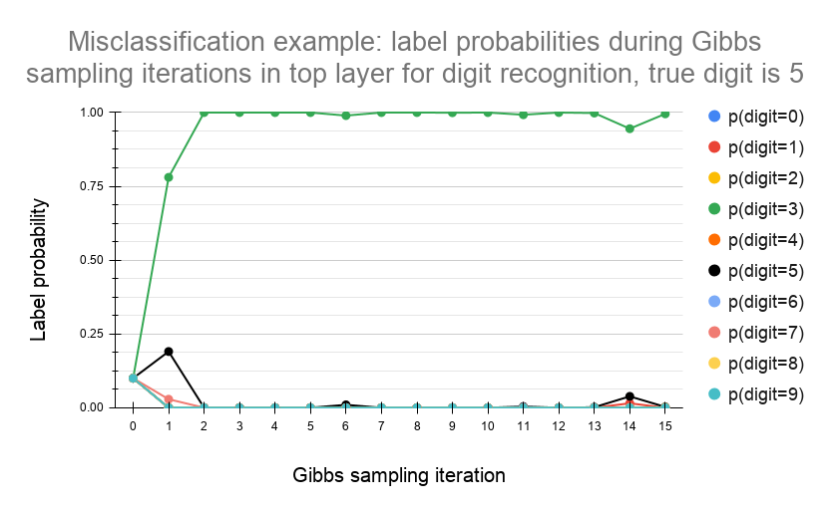
DBN: correct and wrong classification
Notes:
Here we also made graphs to show a correct and wrong classification probability. We can see that generally after 1-2 iterations the network makes up it’s mind and converges. In the left example it converges to the right digit, whereas in the left we can see a process of the wrong classification. It’s interesting to see that the probability of the right label (digit number 5) was at times quite high, but it still failed to converge.

Slide 8
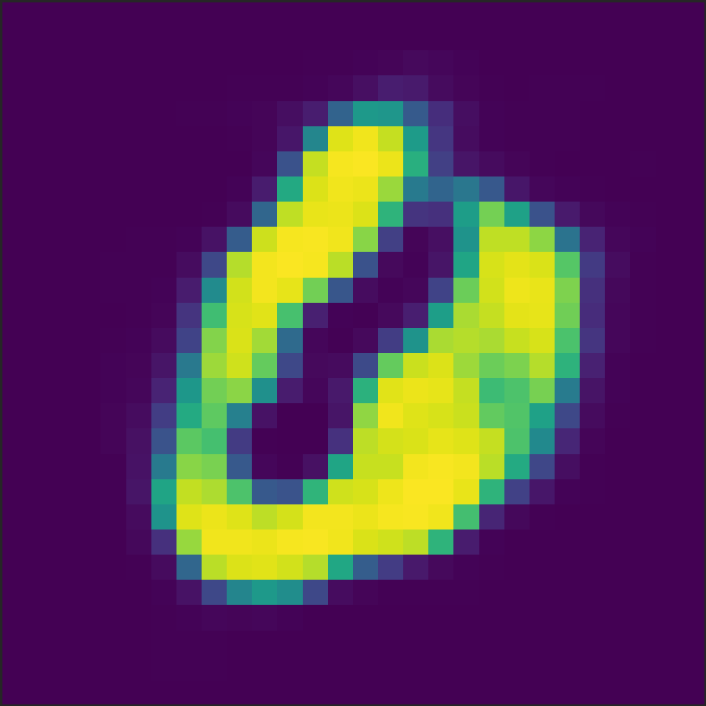
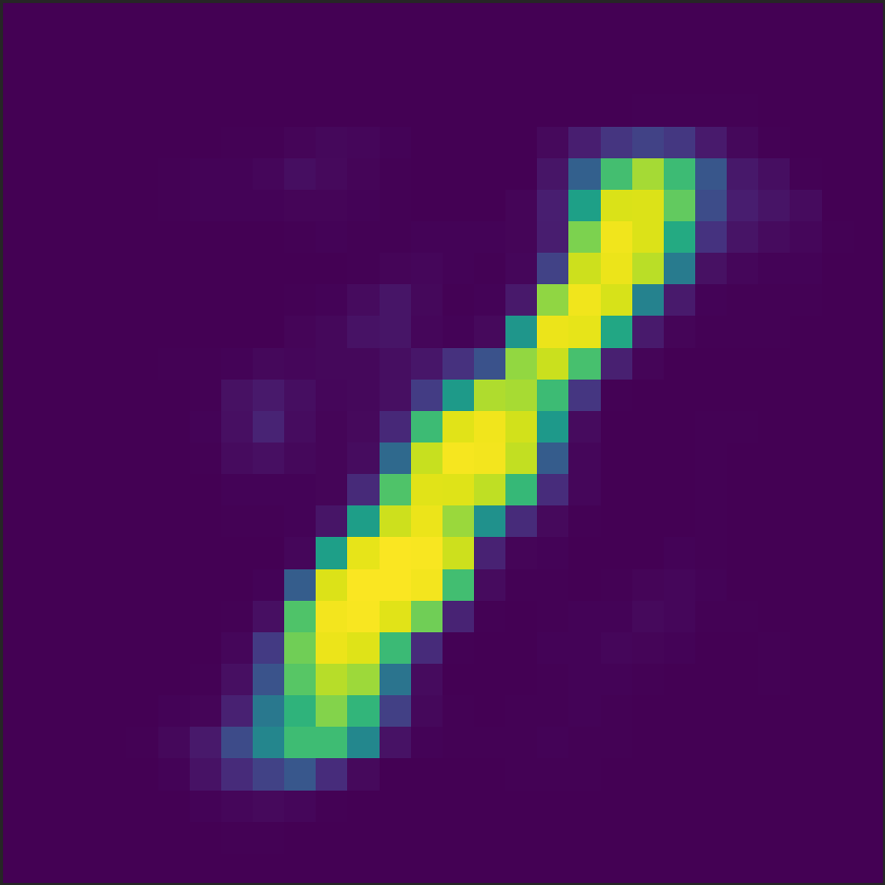
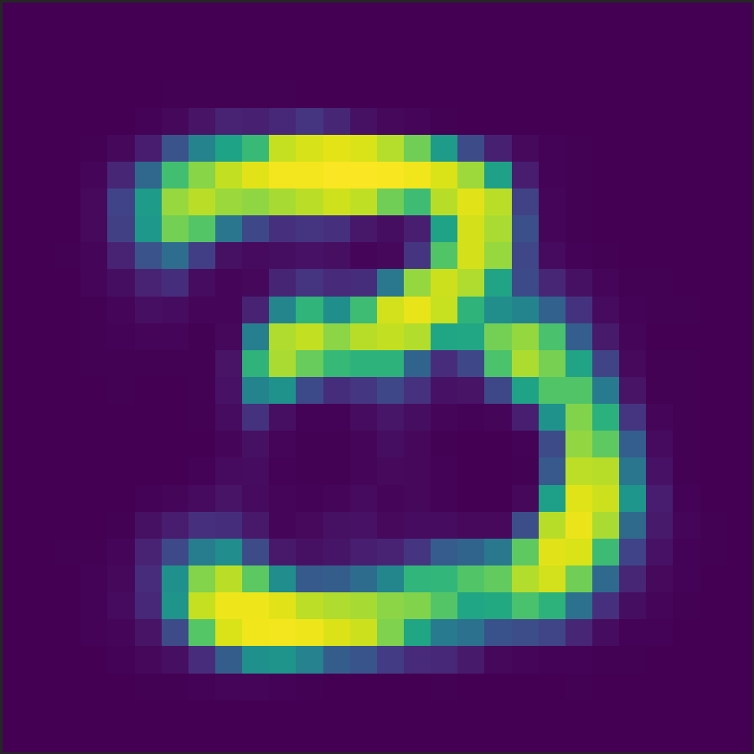
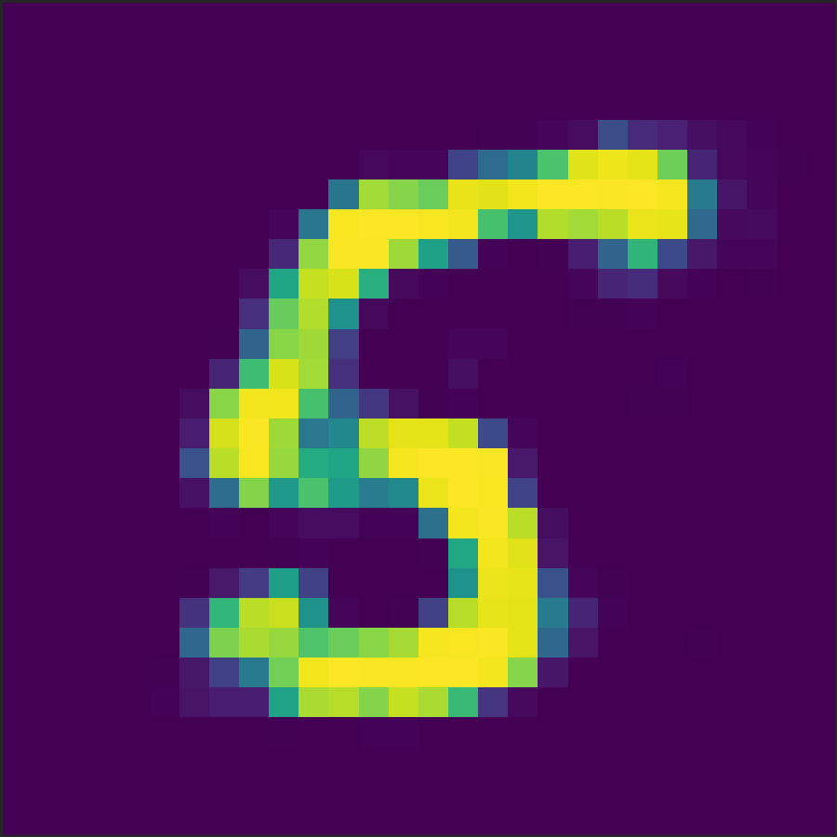
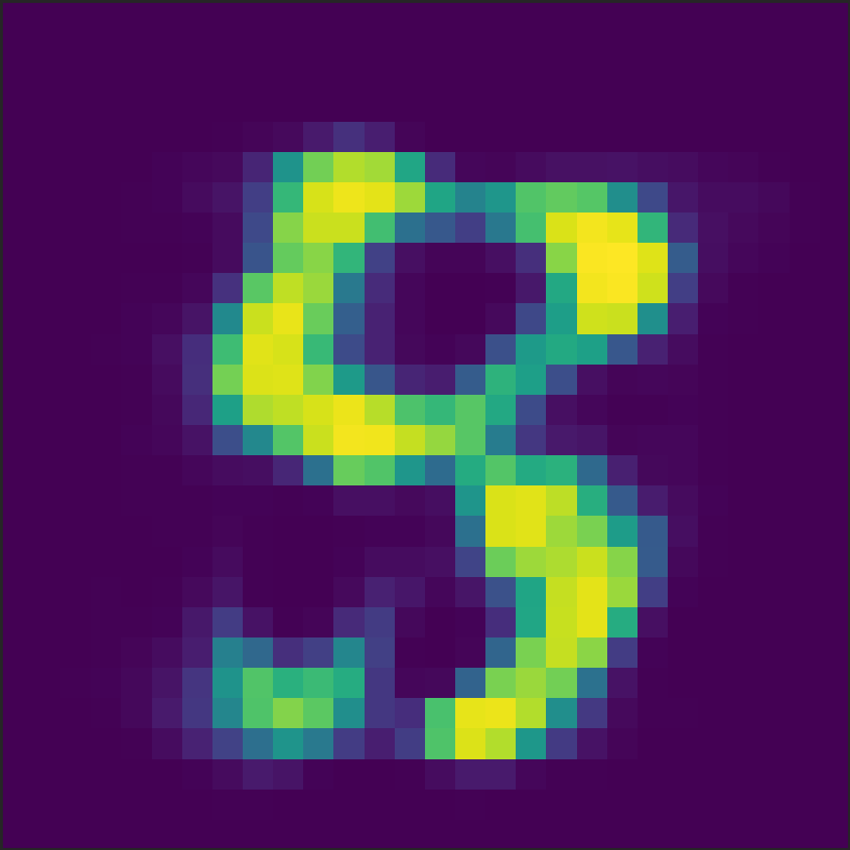
DBN: generation
relatively poor performance, sometimes yields intuitive results
Notes:
Finally, we have tested the generative abilities of our deep belief network. Generally, the performance was pretty poor in terms of the generated patterns and their interpretability. Here we show a few of the good results we received over a couple of networks with different parameters. Usually a single network was able to produce one or two satisfying digits, with the rest being an uninterpretable amalgam of all the digits.
This is the result of several runs

Slide 9
Thank you

